Slide 1
Water Under Climate Change: From Sustainable Management to Resilient Stewardship
Mary Sluder
Indiana University

Slide 2
Mary Sluder
Master of Public Affairs-Master of Science in Environmental Science Candidate at Indiana University
msluder@iu.edu

Slide 3
Climate Change Will Further Reduce Global Water Resources
USA:
Competitive Extraction
Unclear Property Rights
Lack of Monitoring
(Smith et al., 2017; IPCC 2021)

Slide 4
Little evidence exists for which policy instruments are optimal.
(Smith et al., 2017)

Slide 5
Possible Solution: Bottom-Up Economic Policy Instruments
Case Study: San Luis Valley, Colorado
Self-imposed intervention that changed behavior
Decreased groundwater pumping
Top-down literature studies suggest little demand shift in response to a pumping tax.
(Smith et al., 2017)

Slide 6
My Research at COP26:
Importance
Policy Instrument
Implementation
Style

Slide 7
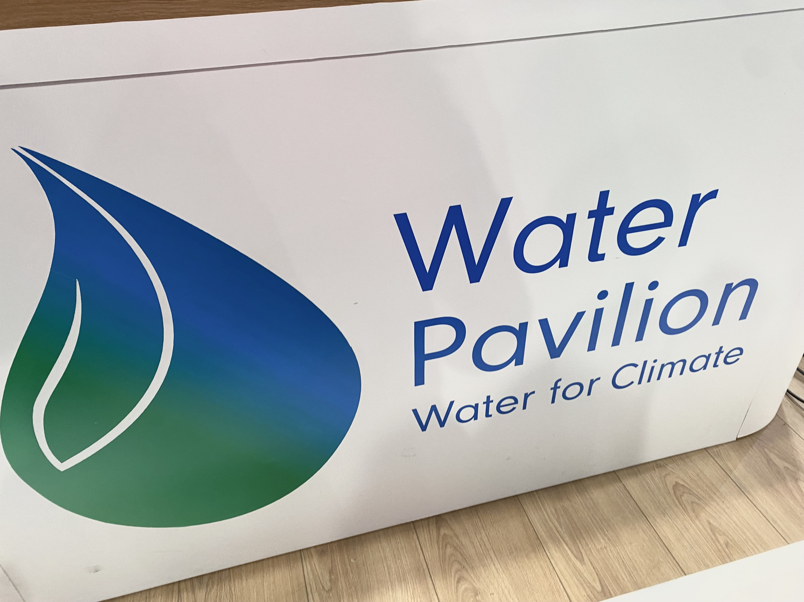
Semi-Structured Interviews with Water Policy and Management Experts
Importance
100% of participants
stated 10/10

Slide 8
Questions Following Case Study Briefing
 | Effective | Replicable | Scale Up
Average | 7.7 | 6.6 | 6.5
Mode | 8 | 6.5 | 7
All participants described the need to empower communities, and that these valuations are context-dependent.

Slide 10
Additional Insights: Participants and Events
Resiliency to climate impacts is crucial
Sustainability is a balance
Sustainability is inherent to stewardship
Stewardship includes stakeholders
Stewardship is equitable
(AWS, 2021)

Slide 11
Conclusion
01
Bottom-Up Support
Collaboration & Collective Action
02
Policy Incentives
Change Behavior
03
Resiliency
To Uncertainty & Impacts
04
Stewardship
Awareness & Understanding

Slide 12
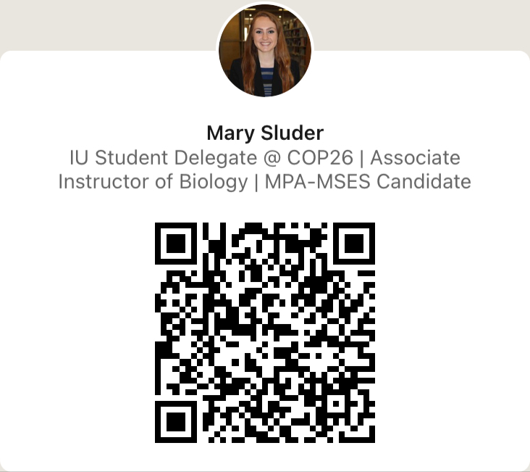
Thank you!

Slide 13
References
Presentation template designed by powerpointify.com
Alliance for Water Stewardship. (2021, May 27). About The Alliance For Water Stewardship. Alliance for Water Stewardship. https://a4ws.org/about/.
IPCC. (2021). Summary for Policymakers. Climate Change 2021: The Physical Science Basis. Contribution of Working Group I to the Sixth Assessment Report of the Intergovernmental Panel on Climate Change.
Smith, S. M., Andersson, K., Cody, K., Cox, M., & Ficklin, D. (2017). Responding to a Groundwater Crisis: The Effects of Self-Imposed Economic Incentives. Journal of the Association of Environmental and Resource Economists, 4(4), 985–1023. https://doi.org/10.1086/692610.

