Slide 1
SDG 16: Framing the Development of Stable Institutions Confronted by Climate Change
Sarah Viders, Brianna Bruyere, Matthew Brolund, Trevor Mueller, Dominic Scariato

Slide 2
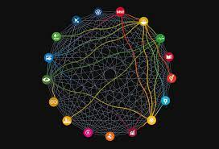
What is SDG 16?
To promote peaceful and inclusive societies that have sustainable development and provide justice for all with stable institutions (Whaites, 2016)
What is a stable institution?
An end state where the state is able to provide the essential services while serving as a responsible steward of state resources (United States Institute of Peace)
Human population needs met
Social justice
Conflicts are managed peacefully
12 Main Targets:
To reduce violence
Stopping organized crime
Protect children from abuse and trafficking
Reducing corruption
Transparent institutions
Strengthen the participation of developing countries
Promote rule of law and to ensure equal justice
Developing stable institutions
Representative decision making
Providing universal legal identity
Public access to information
Enforcing non-discriminatory laws
Why do you all think it is important to have SDG 16 to combat climate change?
Notes:
https://sjankin.com/files/ijcai19-sdg16.pdf
https://www.seedsrenewables.com/wp-content/uploads/attachments/Achieving%20the%20Impossible%20can%20we%20be%20SDG16%20believers.pdf
https://sdg-tracker.org/peace-justice
https://www.usip.org/guiding-principles-stabilization-and-reconstruction-the-web-version/stable-governance

Slide 3
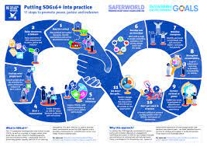
How is the world doing on SDG 16?
Difficult to measure progress
Issue of validity in measurements
Based on availability of data rather than degree to which they track progress on a specific target
Little data available
Not a lot of indicators for the targets
How do you track the trends across 23 different indicators?
A long term goal
Some states still remain a substantial amount away from the target goals
In the 2011 World Development Report, used Singapore as an example of institutional quality and projected countries such as Haiti to take up to 600 years to reach Singapore

Slide 4
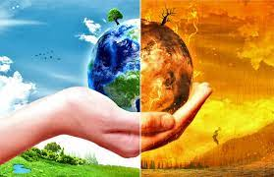
Linking Climate Change to SDG 16
By having accountable institutions, we can promote sustainable development (Dasandi & Mikhaylov, 2019).
Governments and non corrupt organizations to pass policy for better pollution, poverty, and natural disaster protocol
Governance frameworks impact the distribution of the costs and benefits related to the use of natural resources. This includes costs associated with environmental degradation and climate change, and benefits stemming from biodiversity conservation(IUCN).

Slide 5
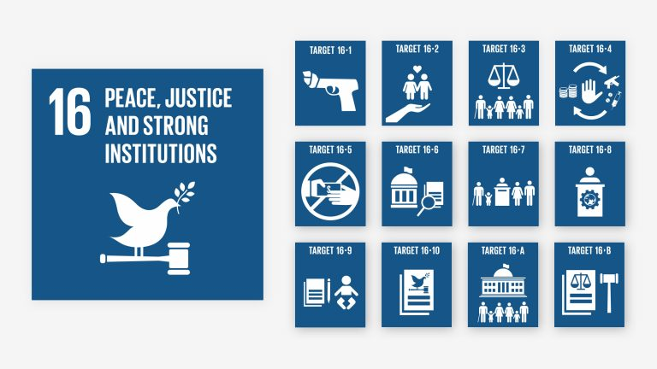
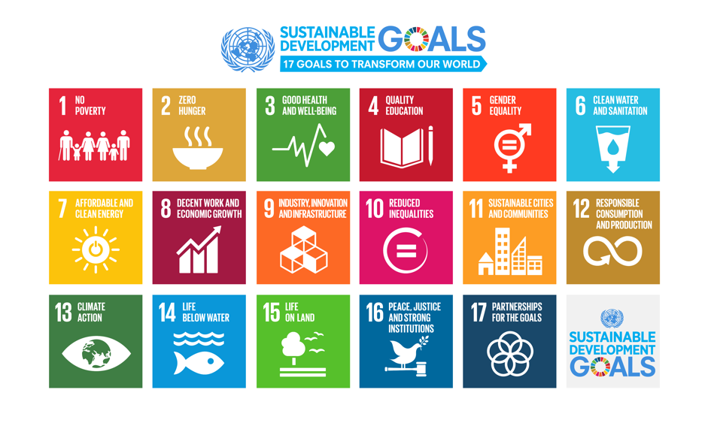
Scientific Research
Sachs, J.D., Schmidt-Traub, G., Mazzucato, M. et al. Six Transformations to achieve the Sustainable Development Goals. Nat Sustain 2, 805–814 (2019)
Transformation 4 - rapid decarbonization and sustainable industry
Sustainable industry as necessary for green development
Glass, L.M., & Newig, J. Governance for achieving the Sustainable Development Goals: How important are participation, policy coherence, reflexivity, adaptation, and democratic institutions? Earth System Governance, (2019)
Democratic institutions and participation explain well past SDG achievement
Strong, representative governments handle climate crisis better than weak, insular governments
To achieve SDG goals going forward, need to strengthen political processes
Fuso Nerini, F., Sovacool, B., Hughes, N. et al. Connecting climate action with other Sustainable Development Goals. Nat Sustain 2, 674–680 (2019)
Combating climate change can reinforce all 17 SDGs
Inherent connectivity of all aspects of development
Institutions as instrument for change, but no analysis on the institutions themselves

Slide 6
Solutions
Real World Examples
Cold War (Jones et al. 2012)
2011 World Development Report analyzed all post-Cold War cases of civil war and relapse
All but one saw success through adopting an inclusive/democratic government
Mozambique (Naidu, 2001)
Established a democratic government in 1994
Saw increased economic growth due to political stability
Strategy and Reasoning
Strong Democratic Governance
Democratization brings about high longevity for political settlements (Kelsall & Hau 2020)
Strong institutions avoid conditions in which violence appears rational in pursuing claims (Jones et al. 2020)
Outside Action (Jones et al. 2020)
Direct support of government and policy in support of inclusion and development
Create an inclusive environment through empowering all margins of society
Notes:
Kelsall, Tim, and Matthias vom Hau. Beyond Institutions: Political Settlements Analysis and Development. Institut Barcelona d’Estudis Internacionals (IBEI), 2020, http://www.jstor.org/stable/resrep28791.
Naidu, Sanusha. “Mozambique: Prospects for a Lasting Peace?” Mozambique: Prospects for a Lasting Peace?, Clingendael Institute, 2001, pp. 7–30, http://www.jstor.org/stable/resrep05495.4.
Jones, Bruce, Molly Elgin-Cossart, and Jane Esberg. 2012. Pathways Out Of Fragility: The Case for a Research Agenda on Inclusive Political Settlements in Fragile States. New York: Centre for International Cooperation.

Slide 7
Briefing
The effects of climate change on state institutions
The effects of climate change diminish valuable resources that are already sources of conflict
Climate change serves as a threat multiplier, aggravating pre-existing stressors
Strong institutions are necessary to combat climate change so that the distribution of natural resources and accountability may be as far as possible
COP 26 Outcomes
A strong emphasis on long term planning
International assistance in developing states
Solutions
An emphasis on inclusive democratic forms of government
Political stability arises through the promotion of strong economic and democratic growth
This stability provides populations with greater tools to address environmental issues
Actors
The promotion of strong and democratic peaceful institutions occurs on all levels of the state
inter- governmental and industry cooperation
The empowered democratic citizen
Clear and effective communication between all actors involved in the crisis

Slide 8
Sources
Kelsall, Tim, and Matthias vom Hau. Beyond Institutions: Political Settlements Analysis and Development. Institut Barcelona d’Estudis Internacionals (IBEI), 2020, http://www.jstor.org/stable/resrep28791.
Naidu, Sanusha. “Mozambique: Prospects for a Lasting Peace?” Mozambique: Prospects for a Lasting Peace?, Clingendael Institute, 2001, pp. 7–30, http://www.jstor.org/stable/resrep05495.4.
Jones, Bruce, Molly Elgin-Cossart, and Jane Esberg. 2012. Pathways Out Of Fragility: The Case for a Research Agenda on Inclusive Political Settlements in Fragile States. New York: Centre for International Cooperation.
IUCN: Global Policy SDG 16, 2021
UN, Sustainable Development Goals: 16: Peace, Justice and Strong Institutions 2021
https://sjankin.com/files/ijcai19-sdg16.pdf
https://www.seedsrenewables.com/wp-content/uploads/attachments/Achieving%20the%20Impossible%20can%20we%20be%20SDG16%20believers.pdf
https://sdg-tracker.org/peace-justice
https://www.usip.org/guiding-principles-stabilization-and-reconstruction-the-web-version/stable-governance

