Slide 1
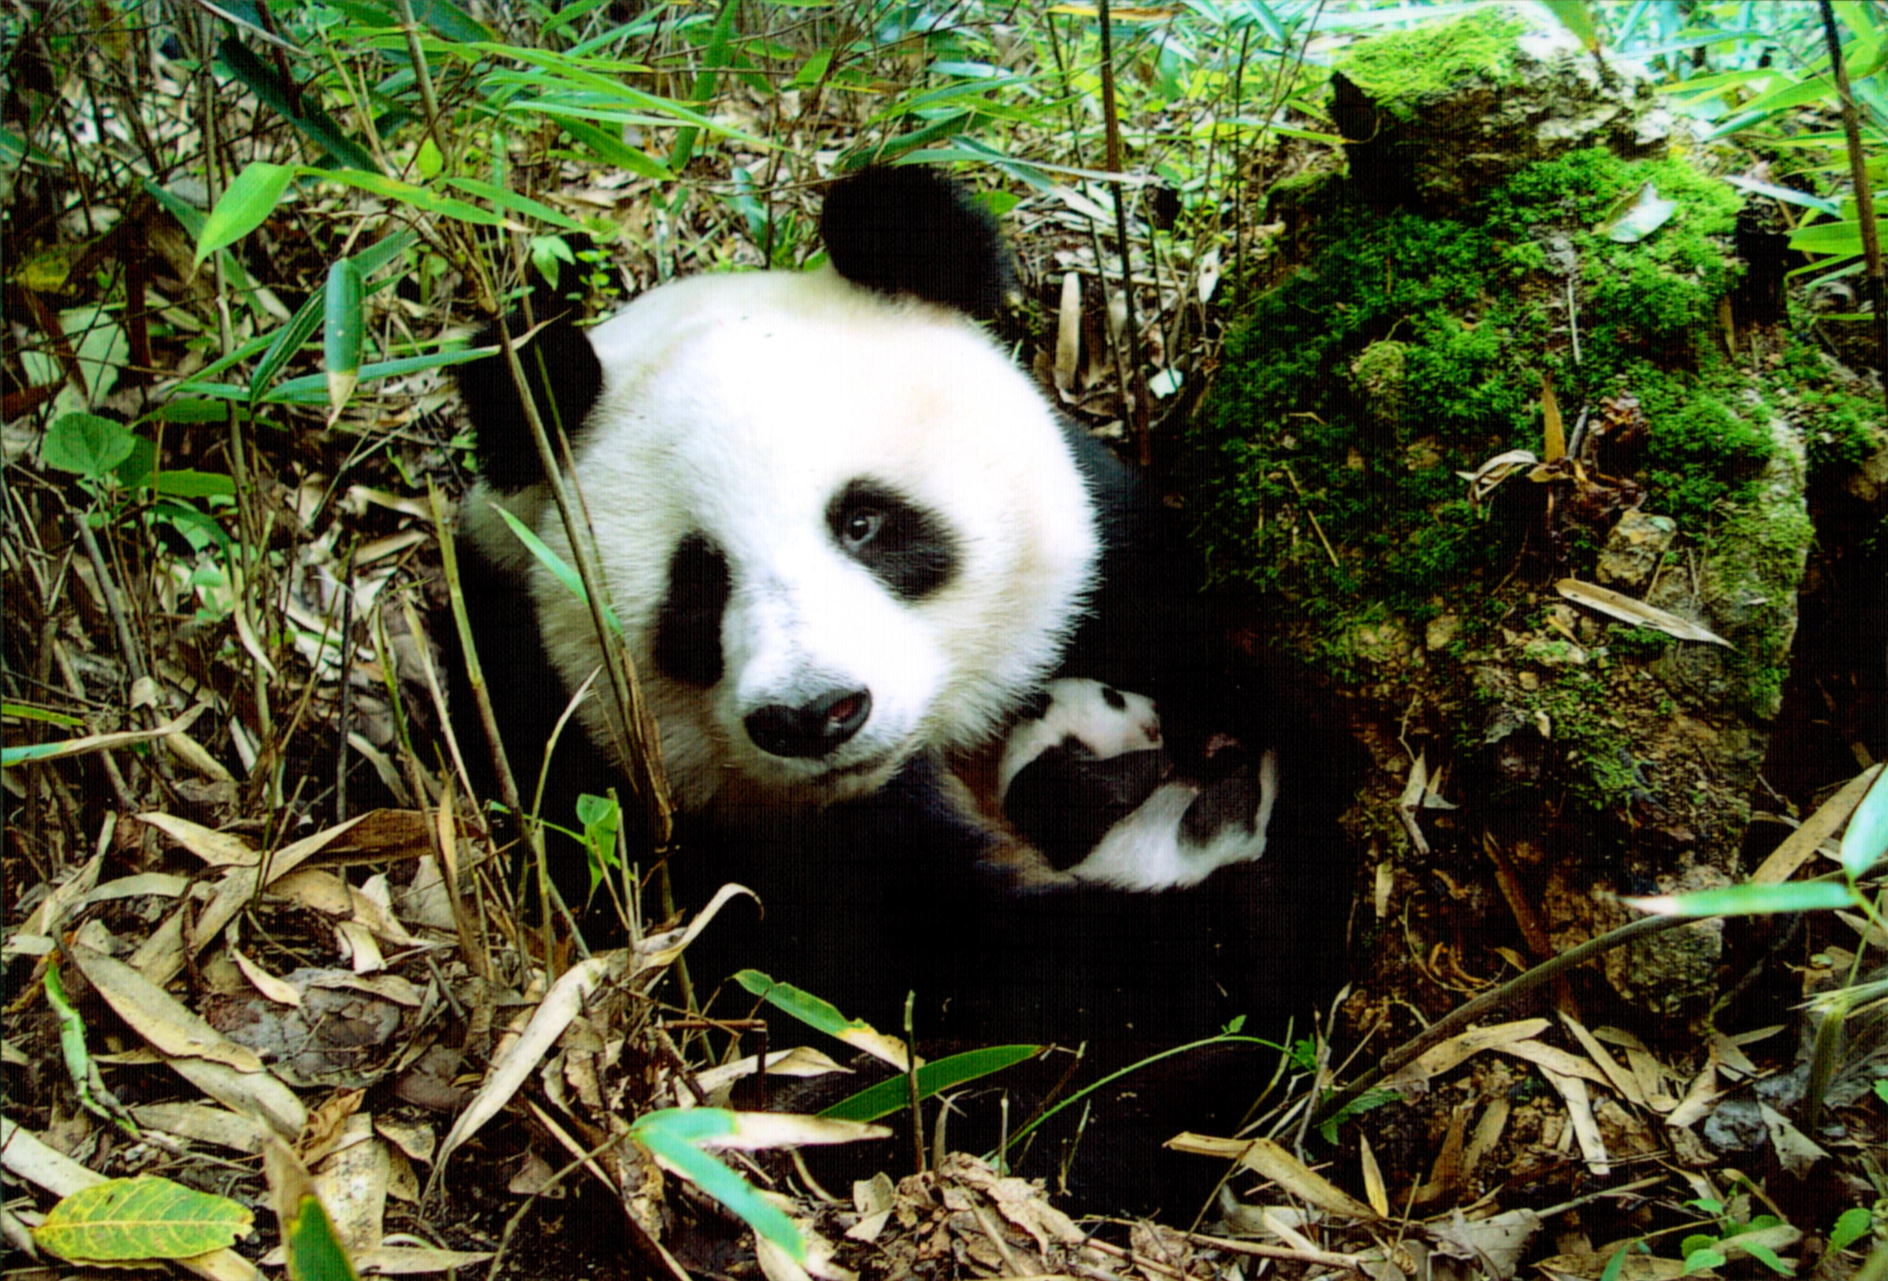
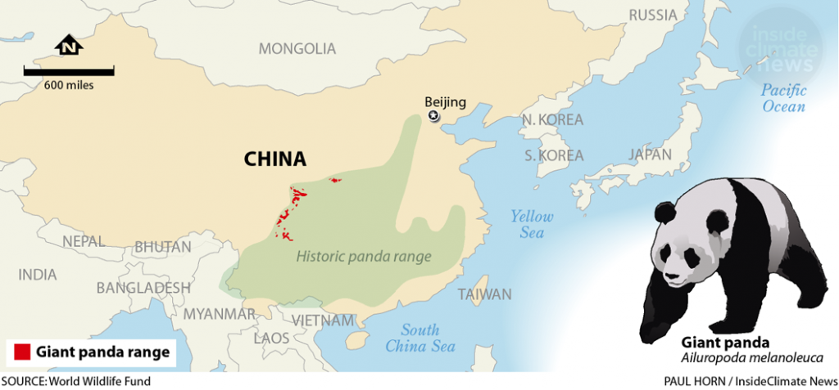
Biodiversity and Ecosystem Integrity in Sichuan Giant Panda Sanctuaries
Sophia Thomas, Shelby Baker, Hunter Ritchie
Biodiversity in the Past
Established 1963
Pandas facing population problems in the 80's and 90's from human impacts
Protecting biodiversity and culture
Sustainable Development Goals
The Sichuan Giant Panda Sanctuaries Overview
Located in Wolong, Mt Siguniang and Jiajin Mountains.
924, 000 ha in area with nine scenic parks and seven nature reserves.
One of the biologically richest areas in the world excluding tropical rain forests.
Protects 30% of the world’s pandas.
Houses multiple endangered species including red pandas.
Climate Change
Generally considered negative for most biodiversity and species
Increasing elevation of forested areas into alpine meadows increasing areas of habitat for pandas
Life on Land
Promotes conservation for many IUCN Red List species
Hotspot for wildlife, protection from urban sprawl
Importance of Biodiversity
Promotes ecosystem integrity
Diminishes effects of major disturbances
Maintains ecosystem services
Benefits tourism and recreation
Quality Education
Chengdu Research Base of Giant Panda Breeding
Nature based tourism
UNESCO and IUCN resources
Yong, Yange. 2 February 2006. Wolong - Mt. Siguniang and Jiajin Mountains. UNESCO. whc.unesco.org/en/documents/113868
Biodiversity in the Present
Giant Pandas are now categorized as a vulnerable species instead of endangered.
Green corridors have been established to prevent inbreeding.
Over 80% of hydropower infrastructure within the sanctuaries have been shut down.
Sichuan World Heritage Management Committee meets twice annually.
Paul Horn. World Wildlife Fund, Inside Climate News. https://blogs.helsinki.fi/vitriblog/files/2018/03/GiantPandasChina1058px-1024x477.png
20 January, 2020. Sustainable Development Goals. Brookings. https://www.brookings.edu/blog/africa-in-focus/2020/01/20/strategies-for-delivering-on-the-sustainable-development-goals-some-lessons-from-rwanda/

Slide 2
Citations
Benn, J. (2006, July 13). Panda Sanctuary in China added to World Heritage List. WWF. Retrieved December 1, 2021, from https://wwf.panda.org/wwf_news/?76460%2FPanda-sanctuary-in-China-added-to-World-Heritage-list.
Chengdu Research Base of Giant Panda Breeding. (2019, March 27). Biodiversity Conservation. Chengdu Research Base of Giant Panda Breeding. Retrieved December 1, 2021, from http://www.panda.org.cn/english/conservation/involved/2019-03-27/7434.html.
China Cultural Center in Den Hang. (n.d.). Sichuan Giant Panda Sanctuaries- China's World Natural Heritage. China Cultural Center in Den Hang. Retrieved December 1, 2021, from https://www.ccchague.org/en/news-show-590.html.
Liu, W., Vogt, C. A., Lupi, F., He, G., Ouyang, Z., & Liu, J. (2015). Evolution of tourism in a flagship protected area of China. Journal of Sustainable Tourism, 24(2), 203–226. https://doi.org/10.1080/09669582.2015.1071380
“Sichuan Giant Panda Sanctuaries.” Natural World Heritage Sites, 30 Sept. 2021, https://naturalworldheritagesites.org/sites/sichuan-giant-panda-sanctuaries/.
“Sichuan Giant Panda Sanctuaries.” Sichuan Giant Panda Sanctuaries - New World Encyclopedia, https://www.newworldencyclopedia.org/entry/Sichuan_Giant _Panda_Sanctuaries
The Nature Conservancy. (2020, July 17). Giant Panda. The Nature Conservancy. Retrieved December 1, 2021, from https://www.nature.org/en-us/get-involved/how-to-help/animals-we-protect/giant-panda/.
UNESCO. (n.d.). Sichuan Giant Panda Sanctuaries - Wolong, Mt Siguniang and Jiajin Mountains. UNESCO World Heritage Centre. Retrieved December 1, 2021, from https://whc.unesco.org/en/list/1213/.
UNESCO. (n.d.). State of Conservation: Sichuan Giant Panda Sanctuaries - Wolong, Mt Siguniang and Jiajin Mountains (China). UNESCO World Heritage Centre. Retrieved December 1, 2021, from https://whc.unesco.org/en/soc/535.
Xiangcheng Mi, Gang Feng, Yibo Hu, Jian Zhang, Lei Chen, Richard T Corlett, Alice C Hughes, Stuart Pimm, Bernhard Schmid, Suhua Shi, Jens-Christian Svenning, Keping Ma, The global significance of biodiversity science in China: an overview, National Science Review, Volume 8, Issue 7, July 2021, nwab032, https://doi.org/10.1093/nsr/nwab032

