Slide 1
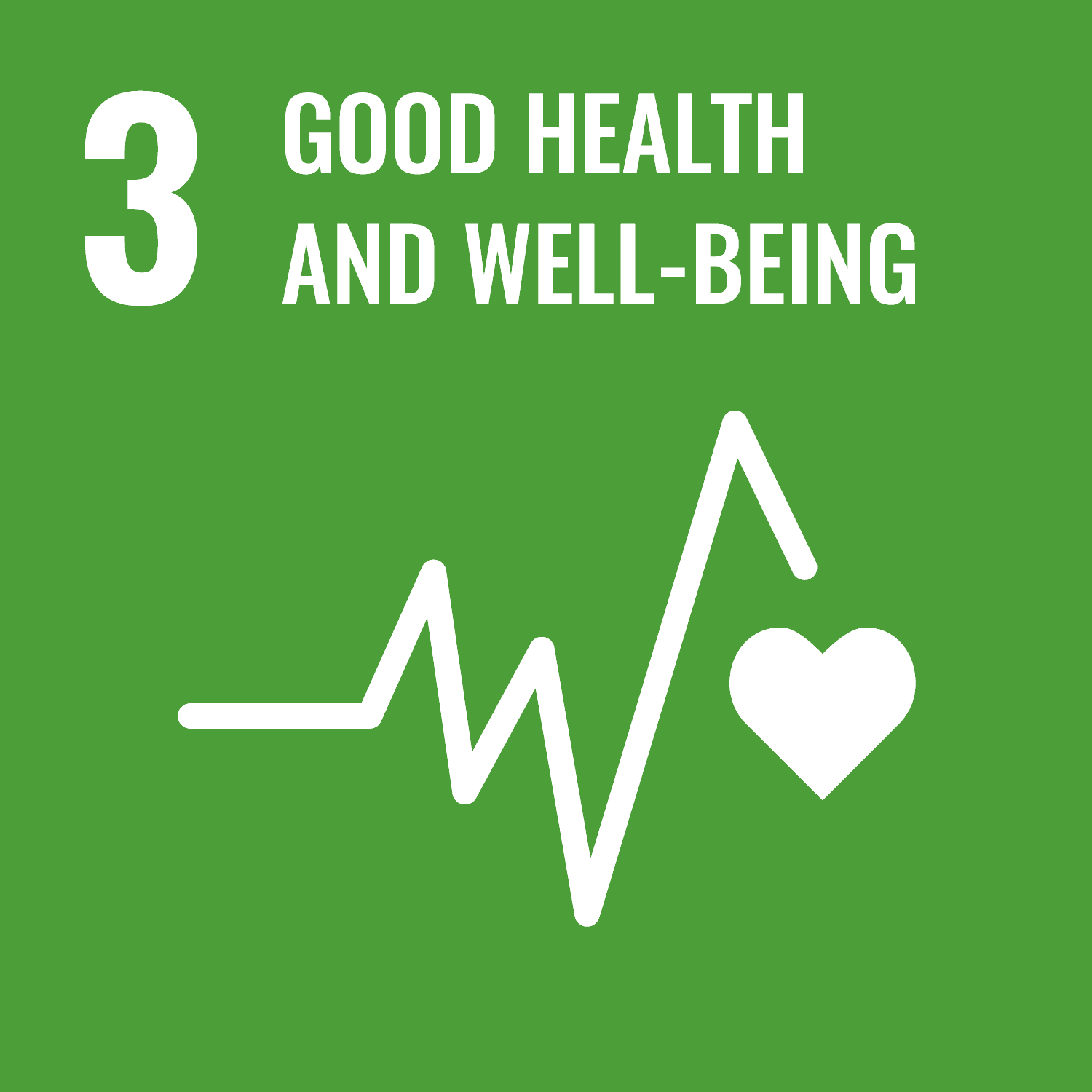
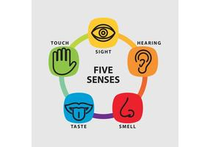
Strengthening America’s Youth
Daily Nature Activities for School Children in the COVID-19 Era
Ryann Hartung
Abstract
Existing Research
Outdoor vs. Indoor Youth Development Study
Conclusion
Kindergarten through grade twelve curricula need to have more nature based recreation programs in their daily lesson plans. This would encourage kids to take control of their own relationship with nature. It could also encourage kids to explore different career paths that would better interest them. Using recess time to go on nature hikes or doing nature therapy techniques would be more beneficial than doing sport games or playground activities.
Concerning COVID-19 recommended guidelines, these activities would be more sanitary and controlled. Students could be masked, distanced and have a more educational experience while still having fun.
.
Hypothesis:
The art assignments that the participants completed outside would lower the blood pressure in participants.
The study:
This study consisted of three participants that were of varying ages. Participant one is a twelve year old male. Participant two is a nine year old female. Participant three is seven year old male. The study was conducted to show the affects that being outside can have on your health. The participants were given an art assignment that they had to complete both inside a building with no windows and then outside in a wooded area. The participants were given no criteria as to how they had to complete the art assignment. The assignment was simply to create an art piece of any environment, outdoor or indoor, within a hour. The purpose was to test creativity and blood pressure of the participants. A control group blood pressure was taken before they completed either the outside or inside assignment. In addition, a twenty-four hour waiting period was given in between the outdoor and indoor portions in order to give the best results.
Overall, the assignment was important for me to be able to stretch my mind and think about why I want to work in outdoor recreation. The first thing I think about is being able help others and outdoor curriculum is one of the first steps to that. Outdoor curriculum not only helps people learn problem-solving but it can also benefit your physical self. Creating positive outlets for youth development is one of the most important things that we can do to ensure growth in America's future.
This Photo by Unknown Author is licensed under CC BY-SA
The importance of outdoor based curriculum can seem low on the priority list. Outdoor curriculum has become more popular due to the fact that is a way that children can become passionate about learning and problem-solving. These experiences allow children to fail and learn to succeed on their own. The learning that occurs is, “beyond “book” learning … [it primarily focuses on] social relationships, physical education, civic participation, the arts, language skills and an appreciation of natural science” (Coyle, 2010, p. 8). These skills may seem silly to some but they are arguably more important because they set a great foundation for learning. These skills create passionate students that can solve problems on their own and don’t rely on anyone else. These students are allowed to be in the outdoors and experience it for themselves with the five senses. This allows youth to be creative and explore nature for themselves. This is so important for youth development and sets up a confident foundation for them to stand on.
Aside from the skill benefits, “outdoor settings appear to reduce ADHD symptoms in children across a wide range of individual, residential, and case characteristics” (Kuo & Faber Taylor, 2004, p. 1). A study done on kids with ADHD showed that when they were exposed to nature they were able to focus better on the information displayed. I think that this shows how important outdoor curriculum is because so many children struggle with at least one learning disability. If being outdoors for their lessons can help them to focus better than that is a resource they should have access to.
References
Beckerman, J. (2020, September 11). High blood pressure in children: Causes, symptoms, treatments. Retrieved April 20, 2021, from https://www.webmd.com/hypertension-high-blood-pressure/guide/hypertension-in-children#2
Coyle, K. J. (2010, September). Back to School: Back Outside! Retrieved April 18, 2021, from https://www.nwf.org/~/media/PDFs/Be%20Out%20There/Back%20to%20School%20full%20report.ashx
Kuo, F.E. & Faber Taylor, A. (2004). A potential natural treatment for attention-deficit/hyperactivity disorder: Evidence from a national study. American Journal of Public Health, 94(9).
Retrieved April 18, 2021, from
http://www.lhhl.uiuc.edu/
Jankovich, T. (2017, November 12). Benefits of learning in nature. Retrieved April 20, 2021, from https://encenter.org/blog/benefits-of-learning-in-nature/
Introduction
“What children need is not new and better curricula but access to more and more of the real world; plenty of time and space to think over their experiences, and to use fantasy and play to make meaning out of them … and to find out what they want to find out.” (John Holt, 2003)
This study is concerning the long-term positive mental and physical health benefits that nature based school activities have on the American youth.
Some of these nature-based activities include but are not limited to: nature walks, meditation in wilderness, birding, and leaf collecting activities. These activities encourage confidence, leadership roles, and good team work. These activities are seen as play to youth, but have a vast amount of underlying learning experience to them.
Data Results from the Study:
Blood Pressure | Control | Outside | Inside (No windows)
Participant 1: | 117/77 | 116/75 | 117/78
Participant 2: | 96/67 | 95/65 | 96/67
Participant 3: | 105/70 | 104/69 | 106/71
Statement of Problem
Students need access to the best possible setting for learning. There is a lack of outdoor based curriculum in K-12 schools and there is a huge need for change. It is proven that nature-based education can decrease the effects of learning disabilities and lower high blood pressure. If there was more access to this kind of curriculum, kids are more likely to have a very well-rounded education.
The results from the study were very interesting and went just as I had hypothesized. When participants were outside their blood pressure lowered and when they were indoors with no windows their blood pressure was higher.
Contact Information
Authors
Ryann Hartung
c/o Dr. Brian Forist, bforist@indiana.edu
Department of Health and Wellness Design
Indiana University School of Public Health
1025 E. 7th Street, Room 133
Bloomington, IN 47405

