Slide 1
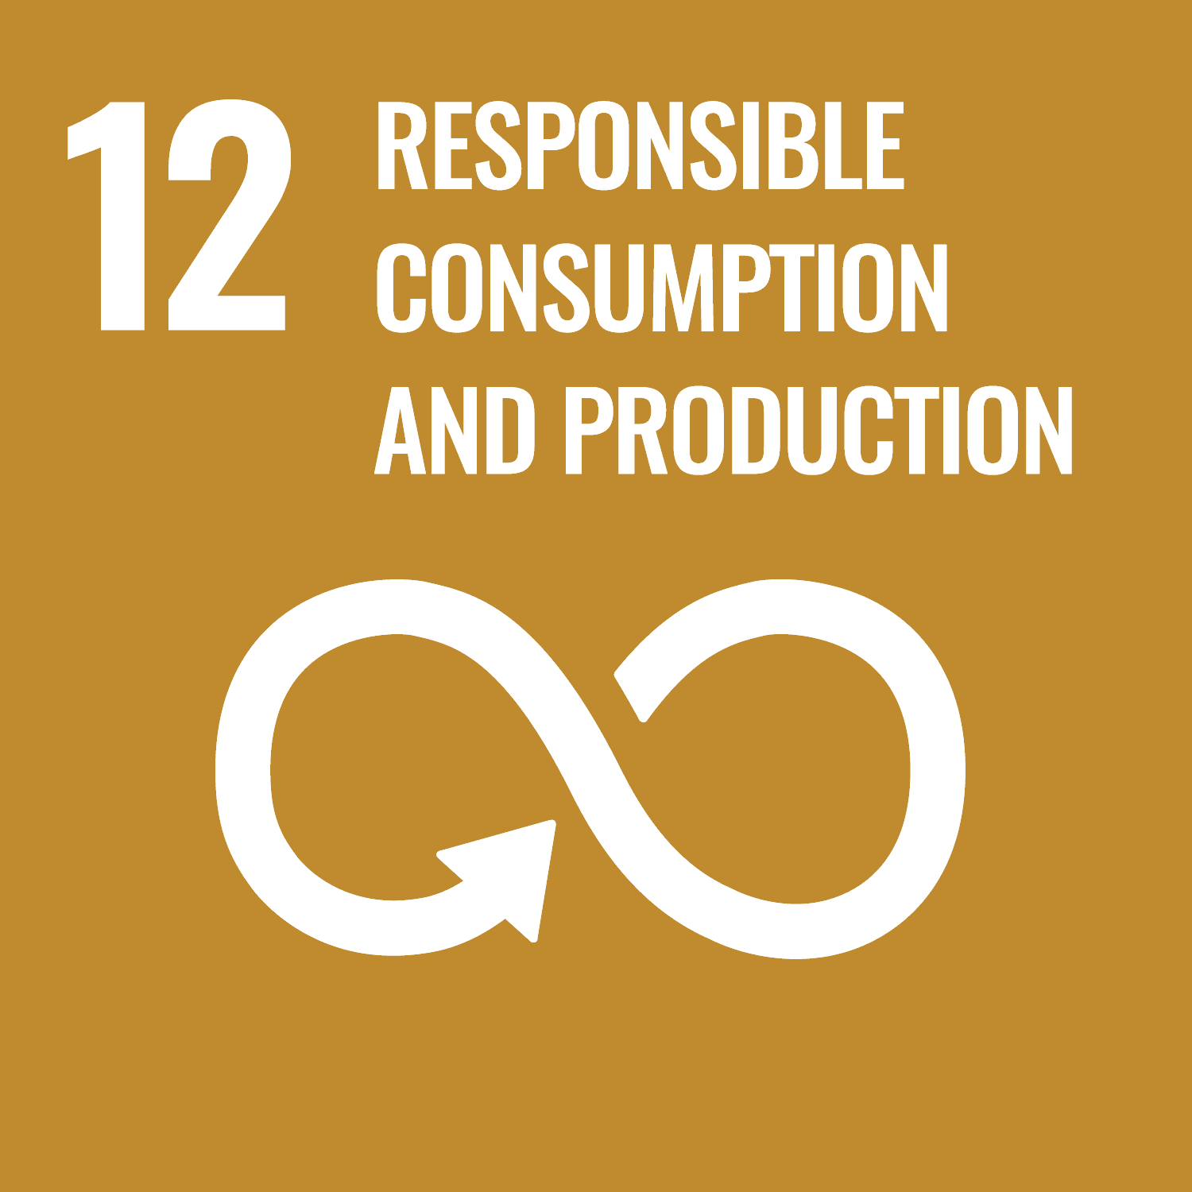
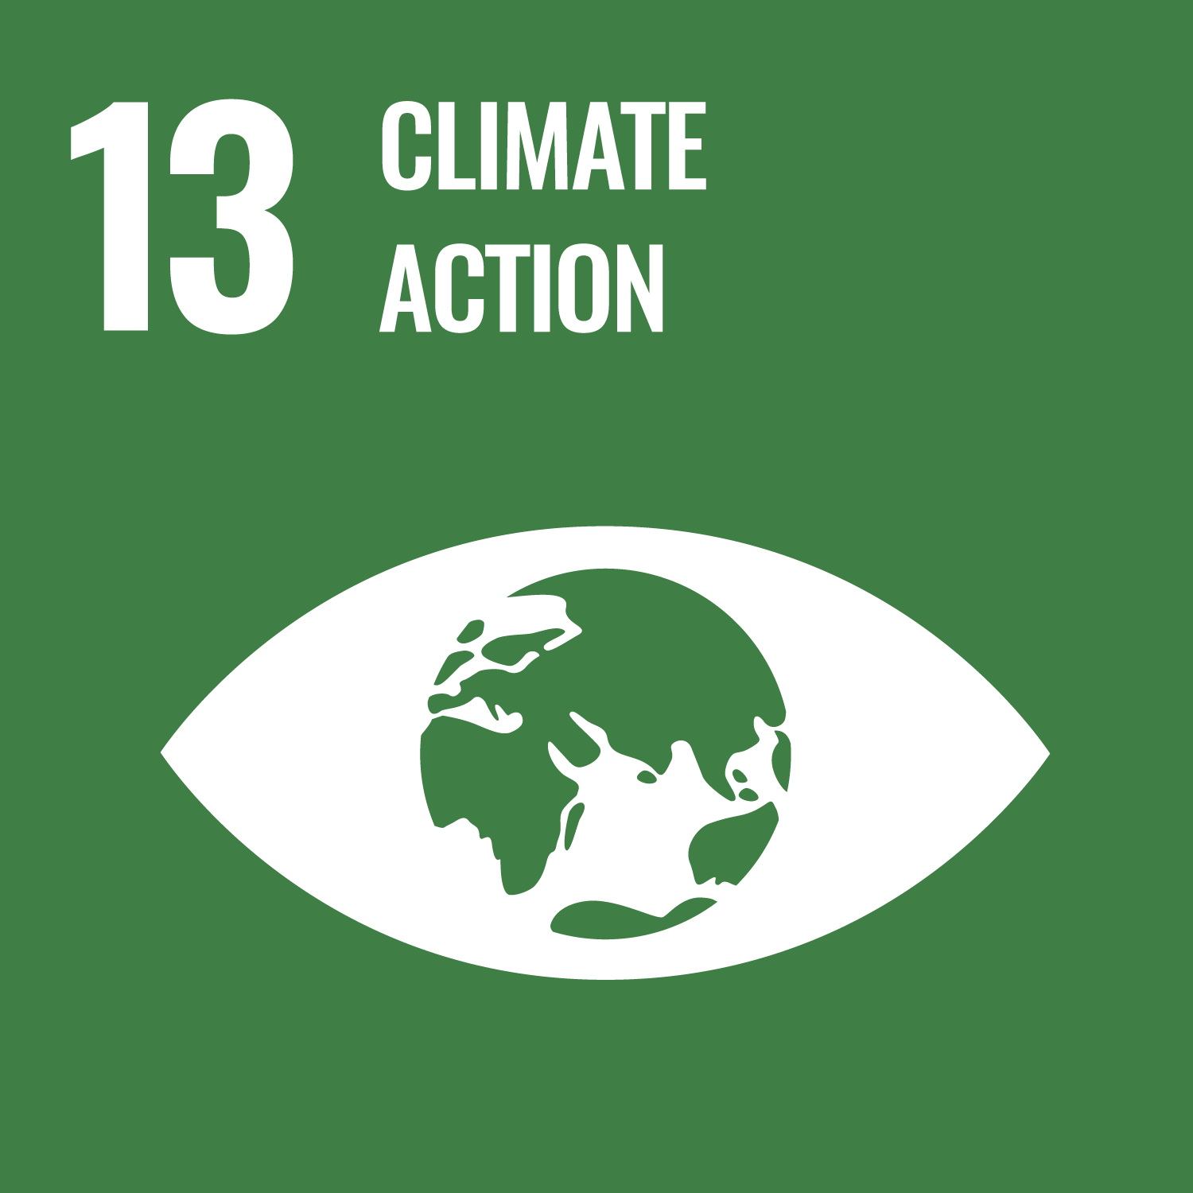
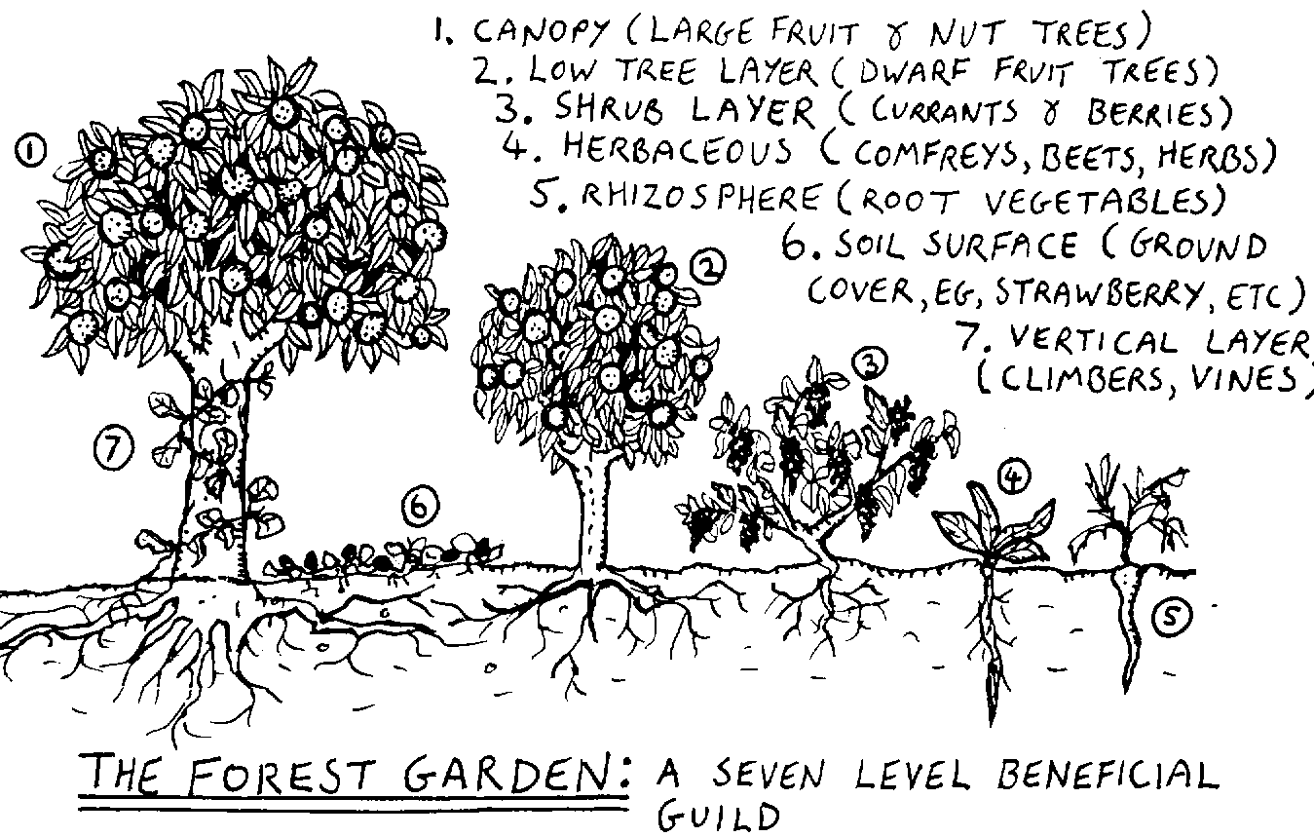
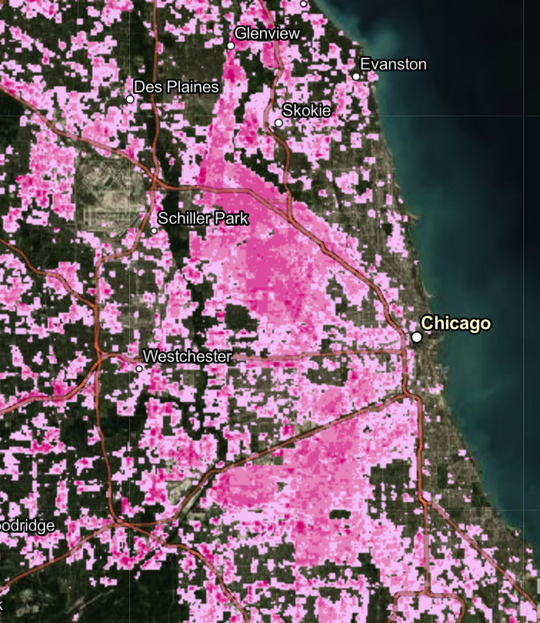
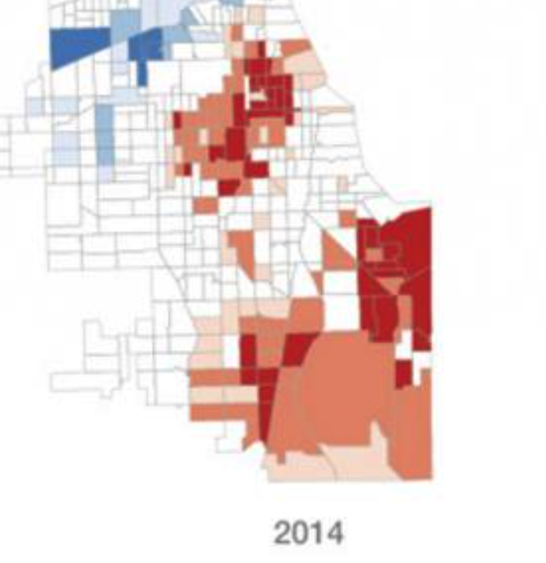
Edible Forests: Addressing Urban Heat Islands Through Food Security
Amanda D’Agostino
Abstract
Urban Heat Islands are built environments that retain heat and lack greenspaces which promote cooler temperatures. According to Jenerette (2011), there is a correlation between lower income and lack of greenspaces in the neighborhood, segregating those with lower financial power. An example of this is the 1995 heatwave in Chicago that killed 700 people, often elderly or lower income residents. (Jenerette, 2011) Developing and maintaining edible forests will help cool the neighborhood and help feed the community with locally grown nutritious food in areas of food insecurity. Partnerships with local farmers, volunteers, community members, and municipalities should be explored.
Conclusion
By planting permaculture edible forests, we can start to ease systemic issues such as food insecurity, heat exposure, and lack of equity in greenspaces. Jenerette (2011) states that, “vegetation has economic, water, and social equity implications that vary dramatically across neighborhoods and need to be managed through informed environmental policies.” Therefore, it is extremely important to gain community input in order to understand their wants and needs before creating a “solution”.
Locations of Urban Heat Islands – Chicago
The dark map shows severity and locations of heat concentration in the Chicago area, with brighter pink being more severe.
Locations of Food Insecurity – Chicago
The white mapping shows severity and locations of food deserts in the Chicago area, with dark red as having less access and dark blue having the most access to stores and markets.
Both maps shown are most severe in communities outside of downtown where cost of living and incomes are less.
The Idea
Turn vacant green lots into permaculture edible forests for public enjoyment. Paths would be required to be universally designed to allow access by everyone. Raised bed garden plots bordering the forest available for low-cost (or free with assistance program) for community members to plant their own crops.
References
Burnett, G. (2018, October 10). Permaculture Photo. Retrieved April 15, 2021, from https://modernfarmer.com/2017/02/plant-food-forest-winter/
Gill, S., Handley, J., Ennos, A., & Pauleit, S. (2007). Adapting Cities for Climate Change: The Role of the Green Infrastructure. Built Environment (1978-), 33(1), 115-133. Retrieved April 9, 2021, from http://www.jstor.org/stable/23289476
IPCC, 2019: Summary for Policymakers. In: Climate change and land: an IPCC special report on climate change, desertification, land degradation, sustainable land management, food security, and greenhouse gas fluxes in terrestrial ecosystems [P.R. Shukla, J. Skea, E. Calvo Buendia, V. Masson-Delmotte, H.-O. Pörtner, D. C. Roberts, P. Zhai, R. Slade, S. Connors, R. van Diemen, M. Ferrat, E. Haughey, S. Luz, S. Neogi, M. Pathak, J. Petzold, J. Portugal Pereira, P. Vyas, E. Huntley, K. Kissick, M. Belkacemi, J. Malley, (eds.)]. In press.
Jenerette, G., Harlan, S., Stefanov, W., & Martin, C. (2011). Ecosystem services and urban heat riskscape moderation: Water, green spaces, and social inequality in Phoenix, USA. Ecological Applications, 21(7), 2637-2651. Retrieved April 15, 2021, from http://www.jstor.org/stable/41416684
Quinn, K. (2020, April 10). Food deserts in Chicago. Retrieved April 15, 2021, from https://storymaps.arcgis.com/stories/e22a3369845340cf8a62d3e0d20a5f0b
Vecchetti, L. (2020, January 10). It's hot out there, and it's not just you. Retrieved April 15, 2021, from https://storymaps.arcgis.com/stories/2a65c5325c164c7cad6d9a0d8fb40ad1
Parks and Recreation Department should focus gardening and naturalist programming at this location.
Grants to explore include; seedmoney.org, Home Depot Community Impact Grant, and Fiskars Orange Thumb Grant.
Policy Recommendation – “Right to Garden”
Allow for residents to garden on their own property without government infringement,
Introduction
Address the unintended impacts of climate change and city planning by intentionally placing greenspace habitats throughout the city. This idea is meant to combat food insecurity, increase access to greenspaces, relieve the impacts of heat deserts, and create working partnerships with local agencies.
Statement of Problem
Unintentional discrimination through policies and other means create disparate impacts for people with less financial and political power.
hoop houses and other temporary structures would be allowed. Illinios HB4704
Existing Research & Knowledge
Gill, (2007) Adaptation strategy to increasing temperatures is to preserve existing areas of greenspace and to enhance it where possible, whether in private gardens, public spaces or streets.
Partnership with Wholefoods in Englewood (neighborhood in Chicago) did not serve the community intended.
Hours did not align with typical jobs held by target market and hours differed in other locations
Priced most community members out of shopping at this store, limiting accessibility to fresh food.
Note: More community input into the partnership, it needs to belong to the community to truly work for the community. Take this opportunity to get to know the people and understand their needs.
Contact Information
Author: Amanda D’Agostino
c/o Dr. Brian Forist, bforist@indiana.edu
Department of Health and Wellness Design
Indiana University School of Public Health
1025 E. 7th Street, Room 133
Bloomington, IN 47405

